Slide 1
Containerizing a Web Application with Docker

Slide 2
Team:SAT
Ahmed Ali 21K-3212 0335-2149666
Taha Hassan 21K-4680 0315-2305271
Shayan Haider 21K-3211 0335-3604985

Slide 3
Problem Statement
Traditional deployment methods lead to challenges such as: - Environment Discrepancies: Applications behave inconsistently across development, staging, and production. - Inefficient Resource Usage: Deployment artifacts are bloated with unnecessary files. - Complex Deployment Pipelines: Managing multiple environment-specific configurations is tedious and error-prone. - Scaling Challenges: Scaling across machines or platforms is cumbersome.

Slide 4
Proposed Solution
Containerization with Docker: - Standardized Environments: Containers ensure consistent behavior across all stages (development, testing, production). - Efficient Builds: Multi-stage builds optimize container images by separating build-time and runtime dependencies. - Simplified Configurations: Use Docker's environment variables for environment-specific adjustments. - Seamless Scalability: Docker Hub and Azure are tools that enabled
automated scaling.
- efficient resource usage: Self termination and enable of containers to optimize resource usage

Slide 5
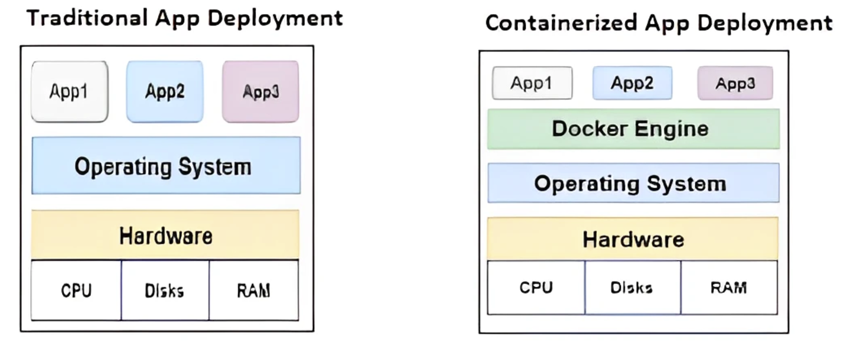

Slide 6
Product Architecture
How product works
User Registration:
A user visits the application via a web browser.
They register by providing a username, email, and password.
The frontend (React) sends the registration data to the backend (Node.js API).
Authentication & Authorization:
Upon successful registration, the user logs in by providing their credentials.
The backend validates the credentials via MongoDB, and on success, generates and sends a JWT (JSON Web Token) for session management

Slide 7
Todo Management:
After logging in, the user can:
Create a new to-do item by entering a task description.
Mark tasks as complete, which updates their status in the database.
Delete tasks, removing them permanently from the database.
Frontend and Backend Communication:
Frontend and backend are containerized in separate Docker containers and interact via API calls.
Backend (express.js) communicates with database (MongoDB) for data persistence.

Slide 8

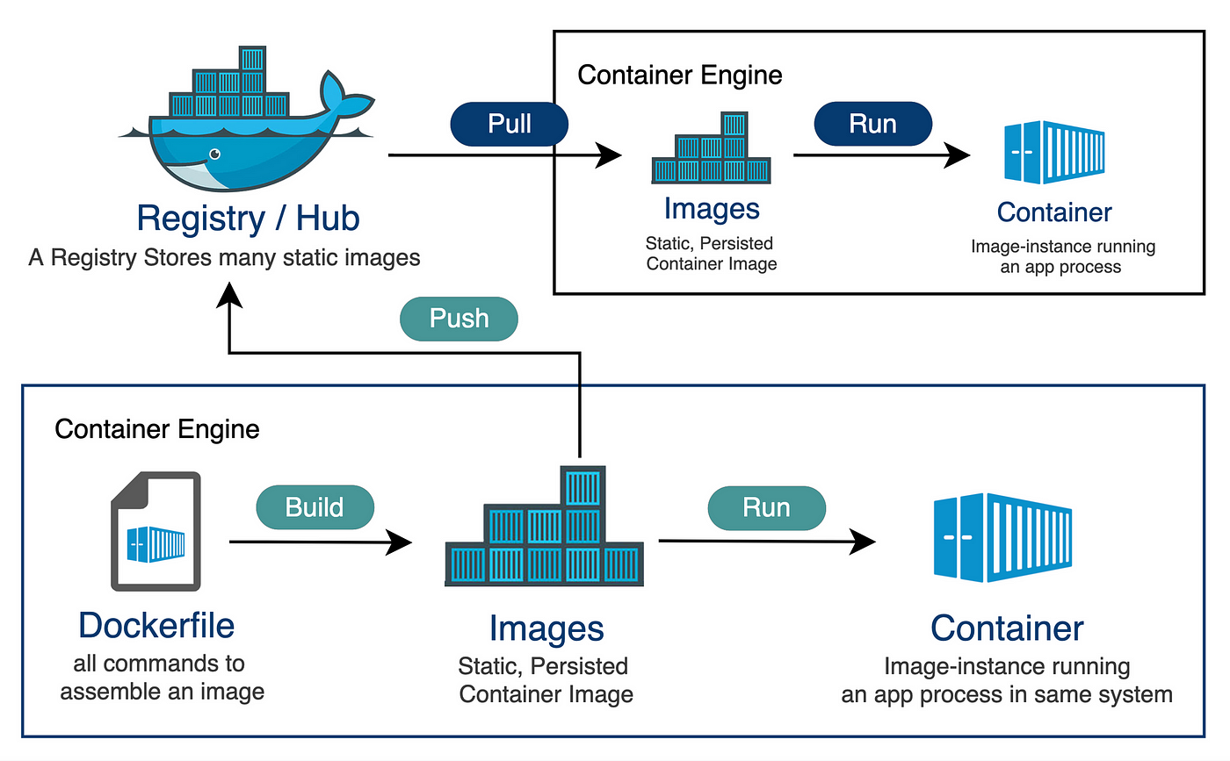




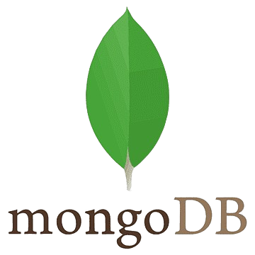

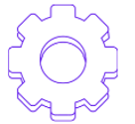
DevOps Solution (Flow Diagram)
main branch
Deployment and monitoring
Pull
Frontend
IDE
Backend
Multistage Containers

